Slide 1
ARM Microprocessor
Ch-1

Slide 2
Brief History
ARM (Advanced Risc Machine) Microprocessor was based on the Berkeley/Stanford Risc concept
Originally called Acorn Risc Machine because developed by Acorn Computer in 1985
An ARM processor is a central processing unit (CPU) that uses a reduced instruction set computer (RISC) architecture. ARM stands for Advanced RISC Machine

Slide 3
Reduced Instruction Set Computing architecture(RISC)
(RISC) architecture is a CPU design philosophy that focuses on simplicity and efficiency in executing instructions.
Here are the key aspects that define RISC architecture:
Simplicity of Instructions: RISC architectures use a reduced set of simple instructions that are optimized for speed and efficiency.
Fixed-Length Instructions: Instructions in RISC architectures are often of uniform length and format. This uniformity simplifies decoding and execution, contributing to faster processing.

Slide 4
Reduced Instruction Set Computing architecture(RISC)
Load/Store Architecture: RISC architectures separate memory access instructions (load and store) from arithmetic instructions. This simplifies the instruction set and enhances performance by reducing the complexity of memory operations.
Efficiency and Performance: They are well-suited for applications requiring fast execution and low power consumption, such as mobile devices, embedded systems, and high-performance computing.

Slide 5
Features of ARM
Energy efficient: ARM processors use fewer transistors, which makes them smaller and more power efficient.
High performance: ARM processors are known for their speed and performance.
Versatile: ARM processors are used in a variety of devices, including smartphones, tablets, computers, and smart devices.

Slide 6
How ARM processors are used
Mobile devices
ARM processors are commonly used in mobile devices because of their energy efficiency and performance.
Embedded systems
ARM processors are often used in embedded systems because of their energy efficiency and performance.
Server and desktop environments
ARM processors are increasingly being used in server and desktop environments.
.

Slide 7
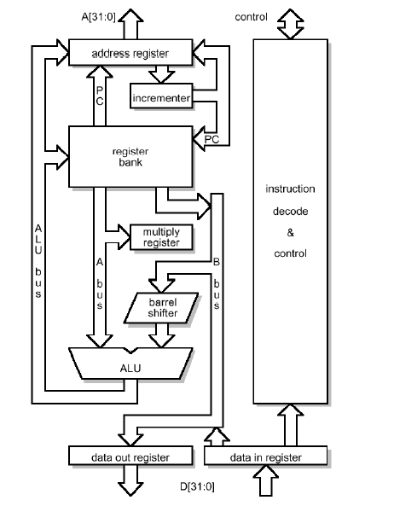
Basics
Only 25 basic instruction types
3 stage instruction pipeline
All instructions are one word long
All instructions are predicated

Slide 8
Basics (Contd.)
All data processing instructions operate on registers only
All data processing instructions can use the barrel shifter (an interesting and unique feature) to shift or rotate an operand
Can operate in either big or little endian mode

Slide 9
Pipeline
3 stage: fetch; decode; execute
Clock Cycle | Fetch Area | Decode Area | Execution Area
1 | Instruction 1 | Empty | Empty
2 | Instruction 2 | Instruction 1 | Empty
3 | Instruction 3 | Instruction 2 | Instruction 1
4 | Instruction 4 | Instruction 3 | Instruction 2

Slide 10
Memory
Arm is a 32 bit microprocessor with one word being 32 bits long
Memory is byte-oriented; each byte of memory has its own unique address
Must use an address divisible by 4 to access a word though

Slide 11
Memory (contd.)
ARM has a 26 bit wide addressing range which allows 64 mb of memory to be directly addressed
Memory Access:
Register Indirect Addressing
Pre and Post Indexed Addressing
PC Relative Addressing
Byte and Word Addressing

Slide 12
Registers
32 bit registers:
13 general purpose registers, R0 to R12
R13 generally used as a Stack register
R14 as the Link register
R15 is the Program Counter and Status register

Slide 13
Program Counter (PC)
Program Counter is in bits 2 – 25 of R15
After fetching an instruction, PC is incremented to next word
PC only needs to be 24 bits in length, though it can address a 26 bit address space
instructions must start at a word boundary thus 2 least significant bits must be zero

Slide 14
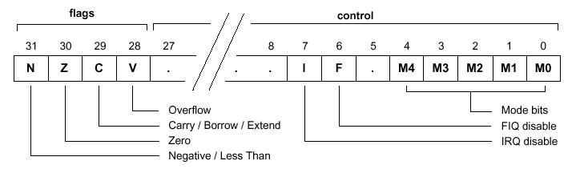
Status Register
Status register bits indicate either processor mode, fast interrupt mode, normal interrupt mode, and also the overflow, carry, zero, and negative flags

Slide 15
General-Purpose Input-Output(GPIO )
At the most basic level, GPIO refers to a set of pins on your computer’s mainboard or add-on card.
These pins can send or receive electrical signals, but they aren’t designed for any specific purpose.
This is why they’re called “general-purpose” IO.

Slide 16
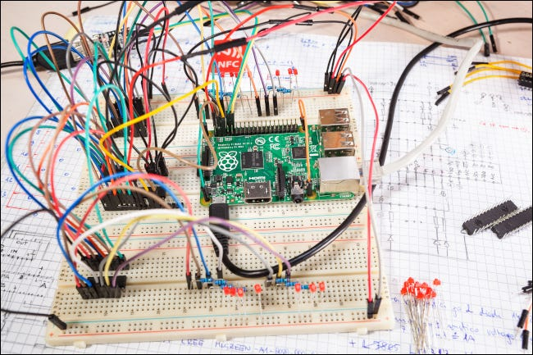
General-Purpose Input-Output(GPIO )
The most common use for GPIO is to operate custom electronics.
Whether you’re building your own robot arm or a DIY weather station, a GPIO interface lets you customize signals so that they operate your equipment correctly.

Slide 17
General-Purpose Input-Output(GPIO )
Analog input/output (I/O) devices enable communication over long distances for sensors on the factory floor or in building automation with control equipment.
Analog I/O signals are used in both factory and build automation to enable smarter sensing and push intelligence at the edge.

Slide 18
ADC/DAC
Analog-to-digital converter (ADC) takes an analog wave as an input and converts this wave to a digitally represented output form.
A digital-to-analog converter (DAC) essentially does the reverse, converting a digital representation into an analog form.

Slide 19
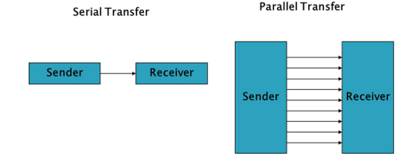
Ch-2: Communication
Data communication types
  Parallel
  serial:
    asynchronous
    synchronous

Slide 20
Parallel Communication:
In parallel communication, all the bits of data are transmitted simultaneously on separate communication lines.
Used for shorter distance.
In order to transmit n bit, n wires or lines are used.
More costly.
Faster than serial transmission.
Data can be transmitted in less time.
Example: hard disk,

Slide 21
Serial Communication:
In serial communication the data bits are transmitted serially one by one i.e. bit by bit on single communication line
It requires only one communication line rather than n lines to transmit data from sender to receiver.
Thus all the bits of data are transmitted on single lines in serial fashion.
Less costly.
Long distance transmission..
Example: Telephone

Slide 22
Serial Communication:
It uses two method:
Asynchronous:
  transfers single byte at a time
  No need of clock signal
  Example: UART (universal asynchronous receiver transmitter)
Synchronous:
  Transfers a block of data (characters) at a time.
  Requires clock signal
  SPI (serial peripheral interface), I2C (inter integrated circuit).

Slide 23
Baud Rate :
Data transfer rate in serial communication is measured in terms of bits per second (bps).
This is also called as Baud Rate.
Baud Rate and bps can be used inter changeably with respect to UART.
The total number of bits gets transferred during 10 pages of text, each with 100 × 25 characters with 8 bits per character and 1 start & stop bit is: For each character a total number of bits are 10. The total number of bits is: 100 × 25 × 10 = 25,000 bits per page. For 10 pages of data it is required to transmit 2, 50,000 bits.
To transfer 2, 50,000 bits at a baud rate of 9600, we need: 250000/9600 = 26.04 seconds (27 seconds).

Slide 24
UART COMMUNICATION PROTOCOL
In UART communication, two UARTs communicate directly with each other.
The transmitting UART converts parallel data from a controlling device like a CPU into serial form, transmits it in serial to the receiving UART, which then converts the serial data back into parallel data for the receiving device.
Only two wires are needed to transmit data between two UARTs.
Data flows from the Tx pin of the transmitting UART to the Rx pin of the receiving UART:
These bits define the beginning and end of the data packet so the receiving UART knows when to start reading the bits.

Slide 25
UART COMMUNICATION PROTOCOL
ADVANTAGES:
  Only uses two wires
  No clock signal is necessary
  Has a parity bit to allow for error checking
  The structure of the data packet can be changed as long as both sides are set up for it
  Well documented and widely used method
DISADVANTAGES
  The size of the data frame is limited to a maximum of 9 bits
  Doesn’t support multiple slave or multiple master systems
  The baud rates of each UART must be within 10% of each other

Slide 26
SPI COMMUNICATION PROTOCOL
SPI is a common communication protocol used by many different devices.
For example, SD card modules, RFID card reader modules, and 2.4 GHz wireless transmitter/receivers all use SPI to communicate with microcontrollers. One unique benefit of SPI is the fact that data can be transferred without interruption. Any number of bits can be sent or received in a continuous stream. With I2C and UART, data is sent in packets, limited to a specific number of bits.

